Slide 1
cavity-cavity interaction

Slide 2
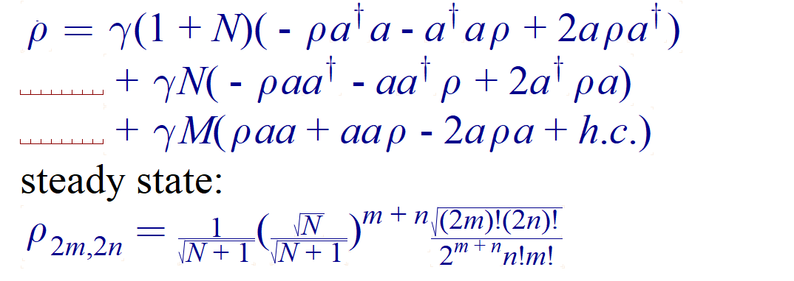

eigen frequency $ν=ω_{0}$

Slide 3
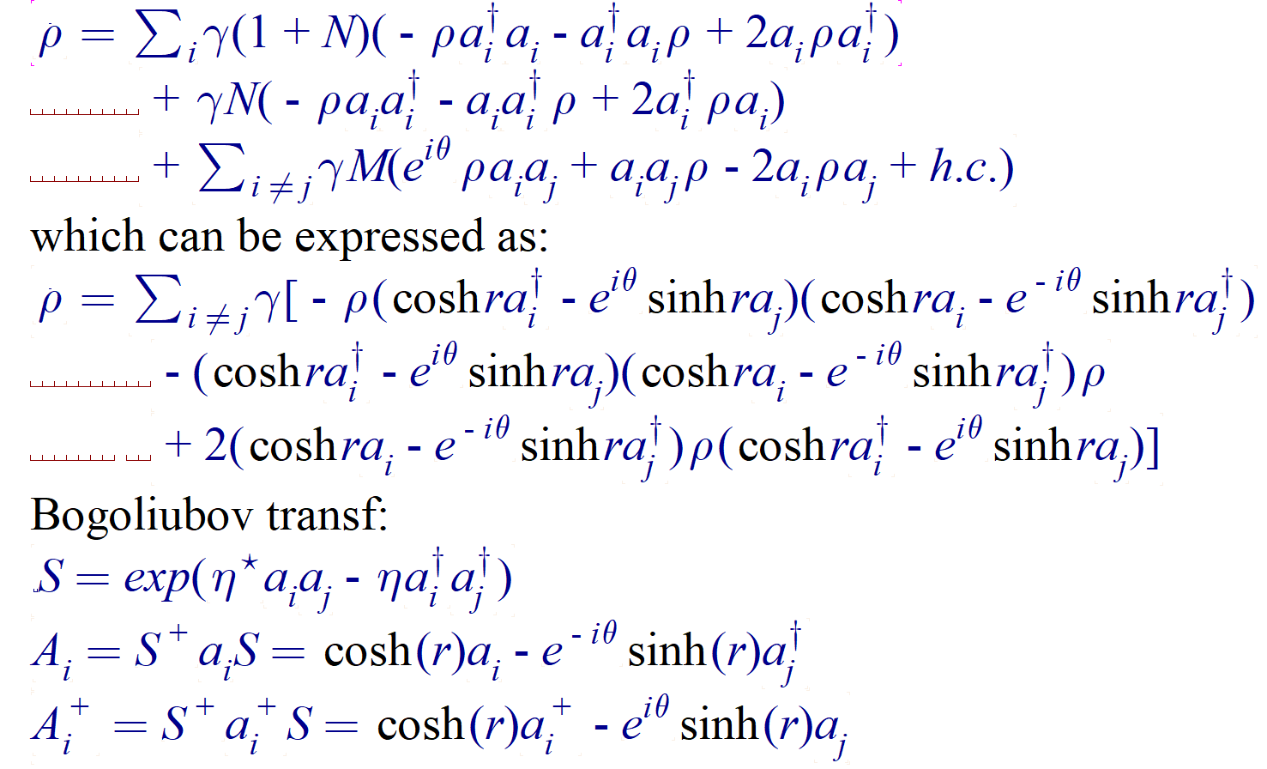
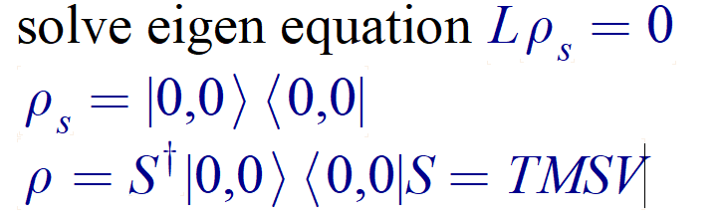


$$ν_{1}=ω_{0}+δ$$
$$ν_{1}=ω_{0}−δ$$

Slide 4
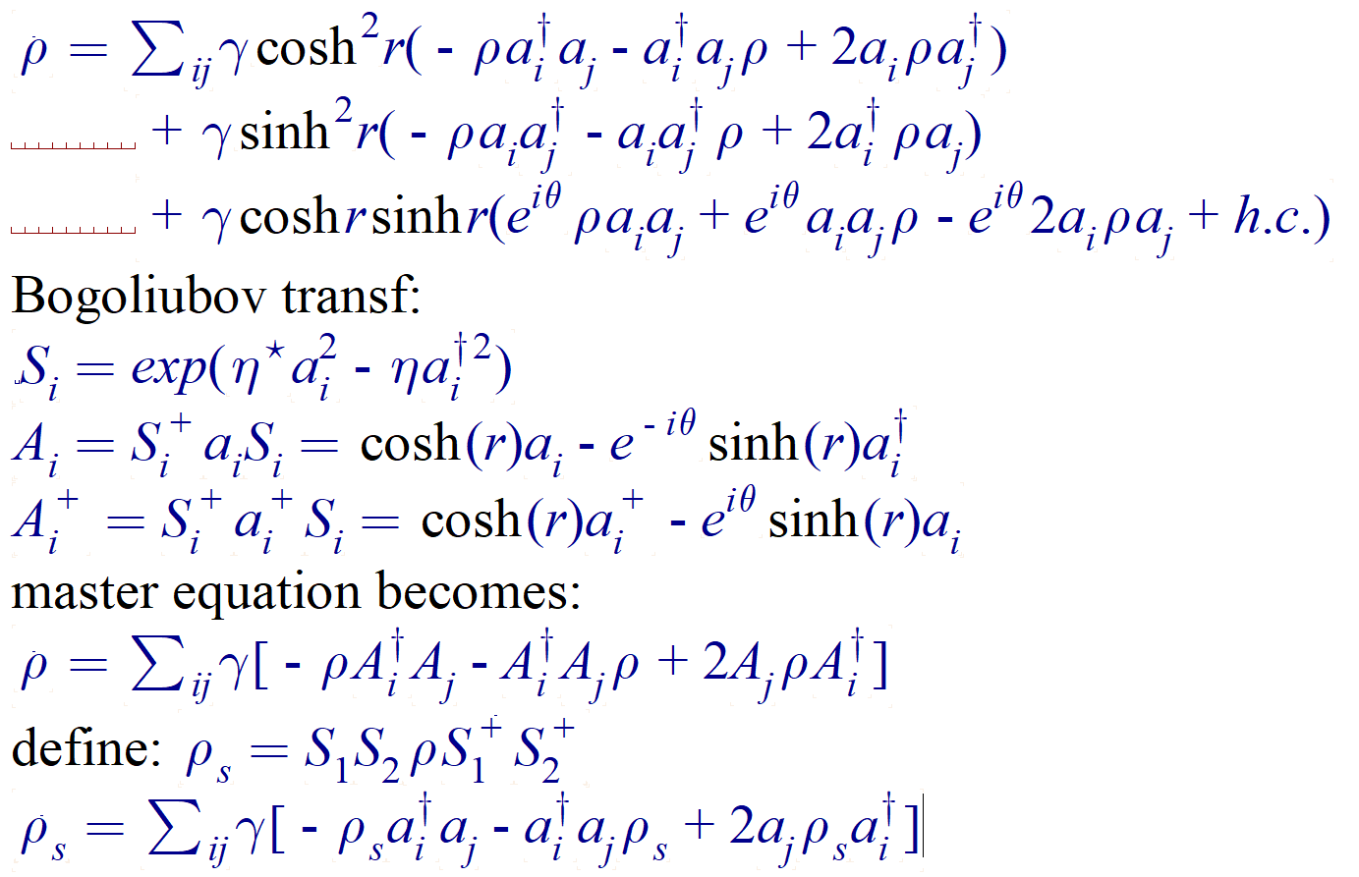
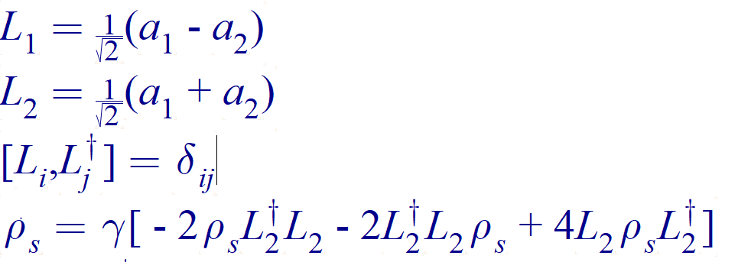
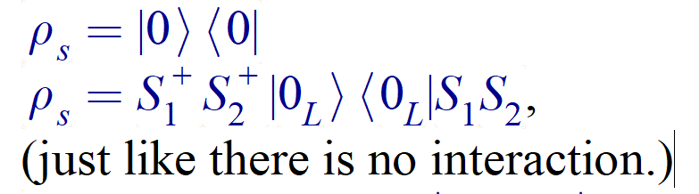


$$ν_{1}=ω_{0}$$
$$ν_{1}=ω_{0}$$

